Slide 1
Natural Language Processing Web/Light Novel Genres Classification
Arno LESAGE, Minh QUAN HOANG, M1 Informatique spé. IA no. 22202985, no. 22509118
29th May 2026

Slide 2
Discovery and Preprocessing

Slide 3


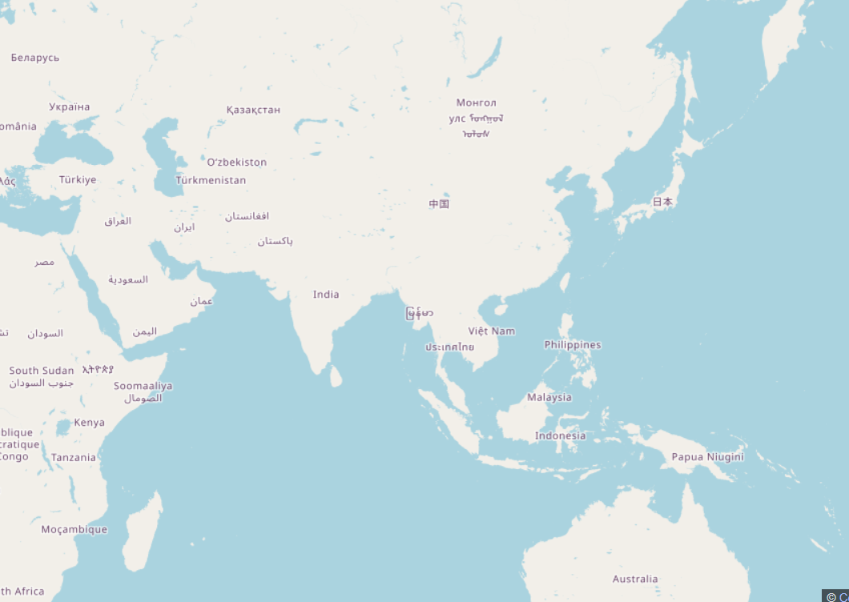




What is a Web/Light Novel?
3

Slide 4
Minor difference between WB and LN?
Light Novel is licenced and have some illustration
Web Novel is unlicenced, often full text and amateur
4

Slide 5
Our dataset, challenges and question.
Source: diverse websites and databases
Kaggle, Prem Schinde, 2024
Classification type Multilabel
Web/Light Novel Dataset
High Imbalance
High Correlation
Predictor 11770 WN/LN English description
Descriptor 35 genres
Some semantic similarity
891 subgenres (tags)
5

Slide 6

+ Novel ID
Title
Authors/Artists
Image (URL)
Description
URL
Alternative names
Show type
Chapter
Status
Related Series
Year
Genres
Tags
Recommendations
Score/Rank/Popularity
6

Slide 7
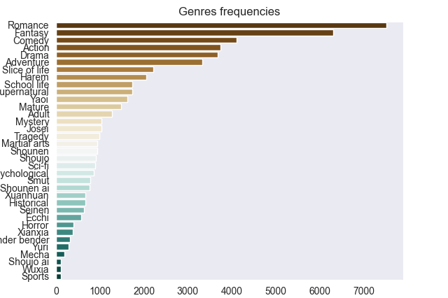
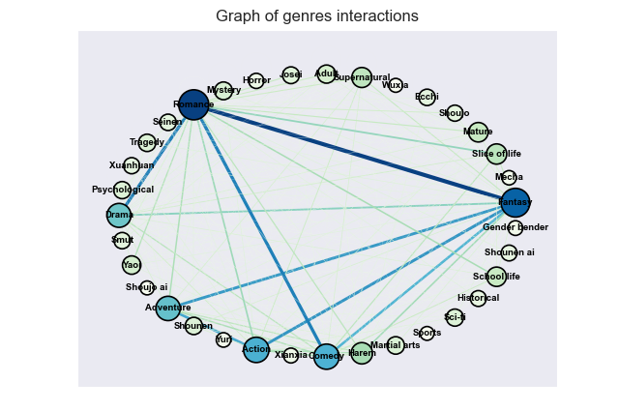
How imbalanced and correlated is the dataset?
7

Slide 8
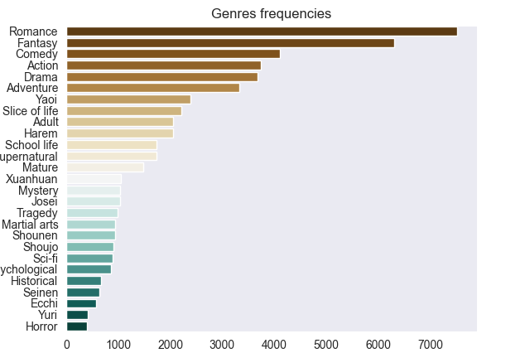
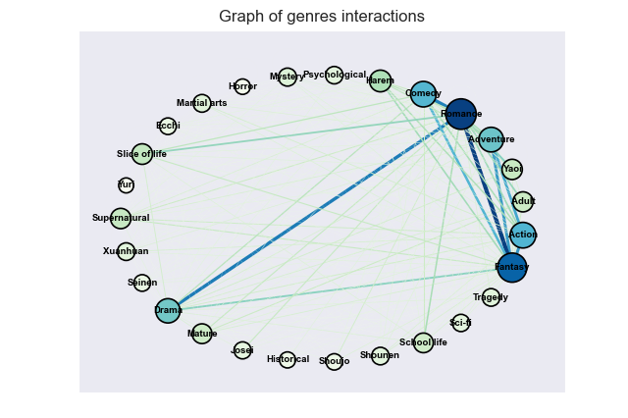

How imbalanced and correlated is the dataset? (2)
$$\#Labels=27 \left(−8\right) \\ Smut→Adult \\ Xianxia→Xuanhuan \\ Shoujo Ai→Yuri \\ Shounen Ai→Yaoi \\ ¬Sport \\ ¬Mecha \\ ¬Wuxia \\ ¬Gender Bender$$
$$Unexpected consequence→Correlation reinforcement$$
8

Slide 9
Bayes and Logistic Preprocessing pipeline
TFIDF Vectorizer (train fit)
Vocabulary reduction
Start
TFIDF filtering (top 0.005%) Vocab: 2190, “unimportant” token filtering
Lemmatization
Normalization
Train-dev-test split
TFIDF (dev, test) Vectorization
Spacy en-core-web-sm
Split hyphens, filter number, remove punctuation, lowercase, remove nltk stop words
Iterative train-dev-test split 75-15-10
End: TFIDF embedding
9

Slide 10
BERT Preprocessing pipeline
Start
BERT Tokenizer
BERT Model
BERT Embedding
Train-dev-test split
End
Transformers bert-base-uncased tokenizer
Transformers bert-base-uncased model
Get CLS Layer
Iterative train-dev-test split 75-15-10
10

Slide 11
Models and results

Slide 12
Models
Bayes
Logistic
MLP over BERT Embedding
Document similarity
12

Slide 13
MLP over BERT Embedding (Correlation)
Classifier layer
Threshold per layer
Corelation layer
Batch of size 100
Activation Normalization + GELU + Dropout 0.3
Bias Multiplication
Activation Tanh
BERT Embedding
Dim 768
Shuffle
Dense 27x27
Bias Sum
Result
88 Batches
Dense 768x512
Dense 512x27
Criterion BCE with logit loss
Aggregation layer
Optimizer Adam
Epochs 50
13

Slide 14
MLP over BERT Embedding (Refinement)
Classifier layer
Refinement layer
Activation Normalization + GELU + Dropout 0.3
Activation GELU
Dense 539x256
Threshold per layer
Batch of size 100
BERT Embedding
Dim 768
Bias Sum
Shuffle
Dense 256x256
88 Batches
Result
Dense 768x512
Dense 512x27
Criterion BCE with logit loss
Aggregation layer
Optimizer Adam
Epochs 50
14

Slide 15
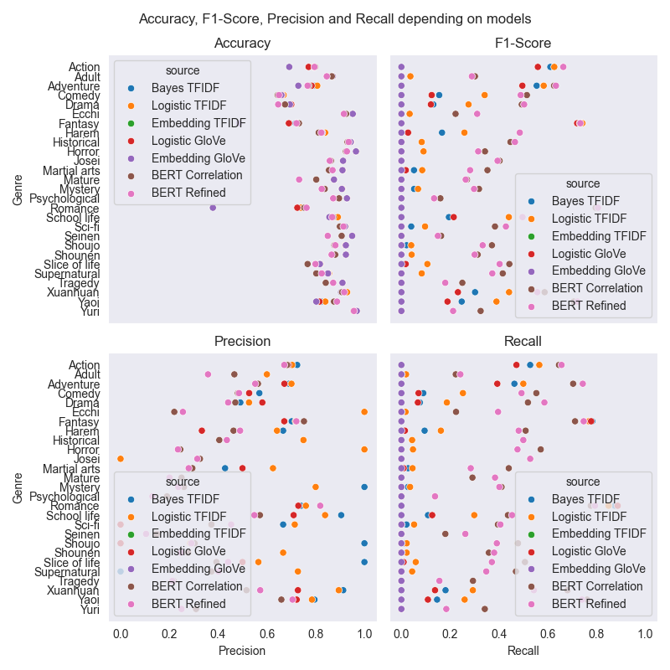
Results by genres
15

Slide 16
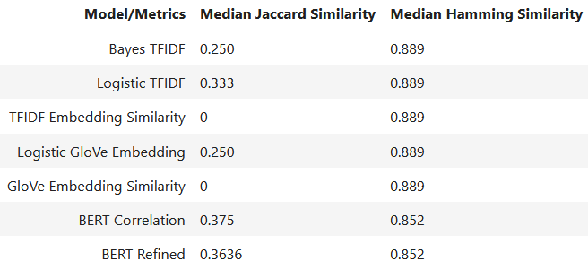
Results by models
16

Slide 17
Jaccard VS Accuracy
Accuracy Perfect match Meaningless because of imbalance
Jaccard Account for partial matches Work in imbalanced environment
17

Slide 18
Conclusion

Slide 19

Thank you for your attention
Arno LESAGE, Minh QUAN HOANG

